Slide 1


RE.AI SOLUTIONS
AI-Powered Virtual Staging
Presented by Brandon Matias

Slide 2

The Problem in Staging
Key Challenges in Real Estate Marketing
Empty homes tend to sell slowly and for less, creating a significant barrier for sellers. Traditional staging is expensive and current digital tools often lack reliability and affordability.

Slide 3

Introducing RE.AI Solution
Transforming Empty Spaces into Homes
RE.AI Solution revolutionizes real estate staging by providing a web-based platform that converts empty room photos into beautifully furnished images instantly, ensuring 100% architectural integrity and market readiness.

Slide 4
Technical Architecture
Frontend System
The frontend is built on Replit, utilizing GCS-backed Object Storage for efficient file handling and user interactions.
Overview of the system components and AI engines
Database Management
PostgreSQL (Neon) serves as the database, managing job tracking and token usage to ensure smooth operations and performance.
AI Integration
The architecture incorporates primary and fallback AI engines, optimizing image processing capabilities while maintaining reliability and performance.

Slide 5
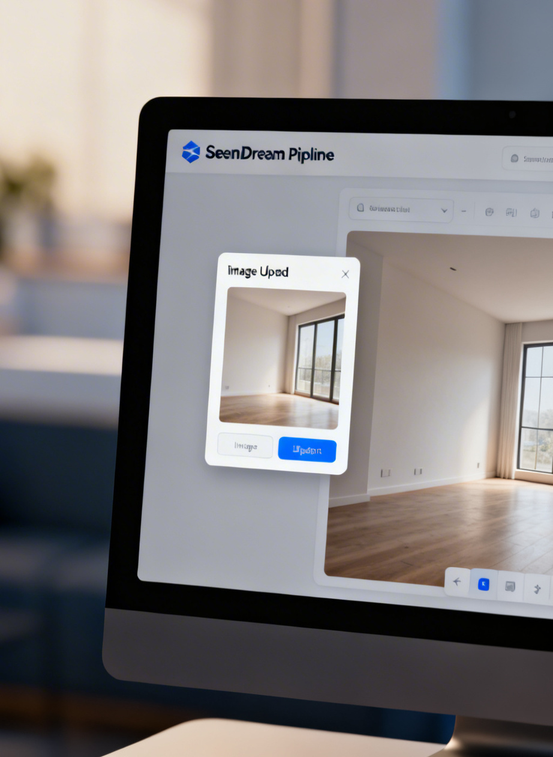
Data Plan
Under the hood deep dive
Source: Custom-curated library of 30+ style-specific prompts for architectural consistency.
Input Data: High-resolution room photos (JPG, PNG, WebP) converted to signed URLs via Replit Object Storage.
Size: Tested on 6 primary indoor room types (Living, Bedroom, Kitchen, Bathroom, Dining, Office) and specialized outdoor/garage categories.
Style Variants: Each room type linked to 5 design styles: Modern, Contemporary, Rustic, Minimalist, Traditional.
Labels/Metadata: Staging requests tagged with a unique Job ID in a PostgreSQL (Neon) database to track room types and styles.

Slide 6
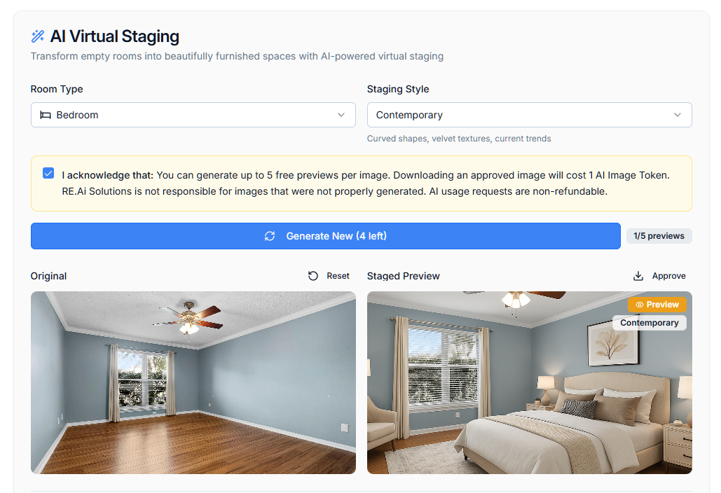
System Design
Style Matrix
The style matrix offers over 30 combinations, facilitating diverse room types and styles for accurate staging representations across various settings.
Key Concepts for Quality and Integrity in AI
Additive Patterns
Our additive patterns effectively ignore walls, windows, and floors, ensuring furniture is placed seamlessly without altering the room's original structure.
Integrity Rules
Established structural integrity rules prevent architectural hallucinations, ensuring realistic outcomes that maintain the original design and layout of the space.

Slide 7
Success Metrics
Prove the solution works and is reliable for professional real estate use.
Primary Metric: Structural Integrity (Accuracy): Aim for 0% errors in permanent architectural features like walls, windows, and floors.
Secondary Metric: Latency (Speed): Deliver high-resolution (1024x1024) images in under 15 seconds per request.
Qualitative Metric: Visual Realism: Ensure furniture appears grounded with natural shadows using "Additive Staging Patterns".
System Reliability: Maintain 100% uptime with an automated fallback to OpenAI’s image API if needed.
User Engagement: Track success with the Token System by measuring how many "Preview" generations lead to final user "Approval".

Slide 8

Project Roadmap
Evaluating RE.AI Solution's History
Phase 1: Foundation & Infrastructure (Dec 2025) establishes the base with AI image enhancement and launches the "Virtual Staging Showcase" on December 3–4. It also implements pay-per-download models and security features by December 5.
Phase 2: Structural Accuracy Sprint (Jan 12, 2026) focuses on precision with ControlNet for better 3D perspective, "Structural Preservation" to maintain room features, and "Forbidden Furniture" lists for style refinement.
Phase 3: Supporting Ecosystem (Jan 19, 2026) introduces Agent Portfolios for users to manage and display staged results.
Phase 4: Optimization & Final Pipeline (Jan 20, 2026) includes migrating to SeeDream 4.5 for architectural consistency and revamping the backend for efficiency, finalizing the Additive Staging Pattern, and specialized logic for garages and outdoor spaces.

Slide 9
Challenges & Mitigations
Model Downtime - Medium
Automated fallbacks to OpenAI API ensure uninterrupted service during model downtimes, maintaining a seamless user experience without delays.
Addressing potential issues and proposed solutions effectively
Floating Artifacts - Low
Implementing refined structural integrity rules minimizes floating furniture artifacts, ensuring realistic staging while preserving the appearance of natural shadows.
Architectural Hallucinations - Low
Strict adherence to structural integrity rules prevents architectural hallucinations, avoiding legal risks and ensuring that generated images retain authenticity and accuracy.

Slide 10
Resources Needed
Compute Resources
Leveraging Replicate API and Replit for hosting will ensure efficient processing and seamless user experiences as image demand grows.
Breakdown of resources, frameworks, and costs.
Framework Implementation
Utilizing Hugging Face with Node.js/Express and Neon/PostgreSQL will enhance performance and scalability for comprehensive AI functionalities.
Cost Estimation
Projecting a $5-$10 cost per 100 images allows for sustainable growth while providing valuable services and robust features to users.

Slide 11

Thank You!
See it in action at: www.reaisolution.com

